Slide 1


Slide 2


Research Organization and Technology Transfer Energy, Mobility and Communication Technology
What is PowerHUB

Slide 3



Main Acitivities
R&D center
Accelerator and incubator
Investment and finance

Slide 4
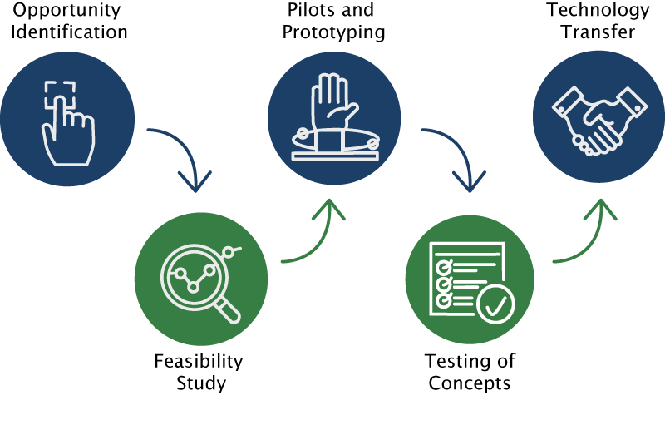
Our approach

Slide 5








Supported projects
Many more at www.powerhub.cz

Slide 6


Why to work with PowerHUB
PowerHUB community
Practical knowledge and
experience
Technology transfer

Slide 7









International partners

Slide 8
Contact
E-Accelerator, z.ú.
Náměstí Kinských 6
150 00 Prague 5
VAT No.: CZ05928541
Lenka Čilová, Regional Director lenka@powerhub.cz
Tomáš Beier, Business Development Manager tomas.beier@powerhub.cz

Slide 9
Thank you kindly for your time

